Slide 1
Change Notifications with Microsoft Graph

Slide 2
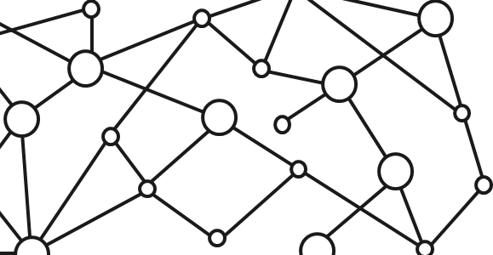
Microsoft 365 Platform
Extend Microsoft 365 experiences
web, device, and service apps
Build your experience
Documents
Pages
Conversations
Timeline
iOS/Android/Windows/Web
1
Microsoft Graph

Slide 3
Change notifications with the Microsoft Graph API
Allows applications to be notified when data changes in the Microsoft Graph
Subscribe to particular notifications
Renew subscriptions for notifications as needed
Combine notifications with track changes for robust data notifications
Use ngrok to simplify local development with notifications

Slide 4
Change notifications with the Microsoft Graph API
Get notifications for messages, events, contacts, users, groups, conversations, OneDrive files & alerts endpoints
Stay up to date and in-sync with data in the Microsoft Graph
No “polling” at regular intervals required
Never miss a change

Slide 5
Example notification scenarios
Translate an email when it arrives
Start a Flow when a document is X many months old
Create new user accounts in your application when a users joins an organization

Slide 6
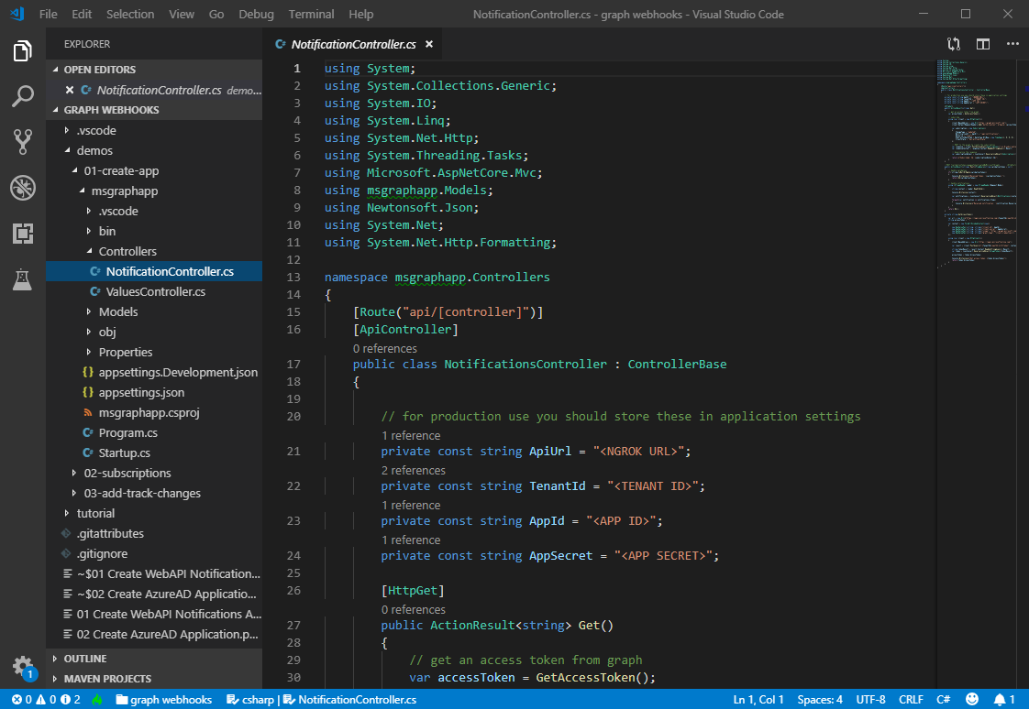
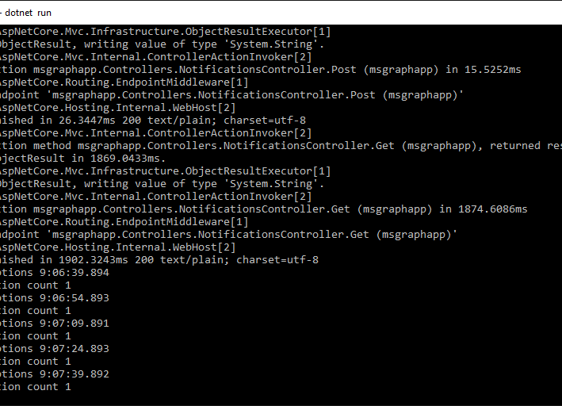
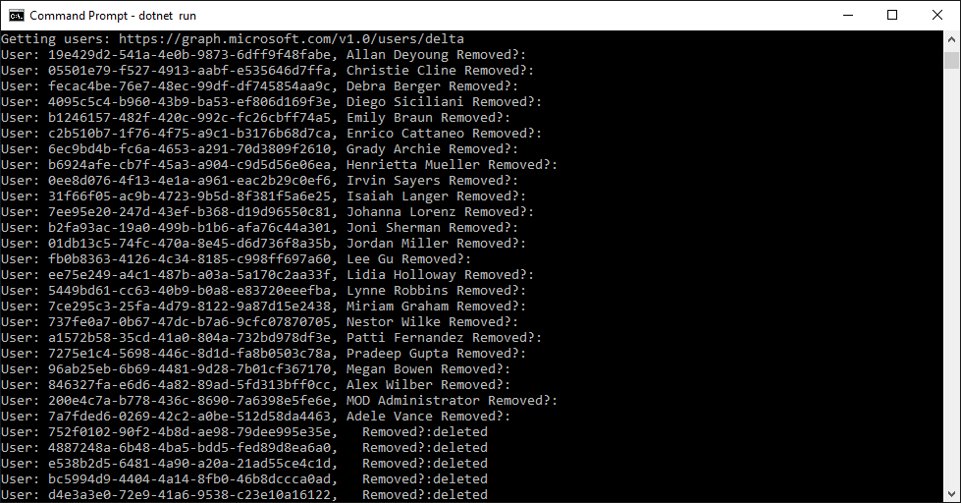
Get notified when user data changes
Create the app
Build a .NET Core WebApi application
Subscribe for notifications
Add code to subscribe to notifications when user data changes
Receive notifications
Add code to handle notifications when they occur

Slide 7
Demo

Slide 8
Thank you.

